Slide 1
Dynamic Region-Aware Convolution Jin Chen, Xijun Wang Beijing Academy of Artificial Intelligence

Slide 2
Background
CNN: Params sharing, translation-invariance.x
Problems: Channels and depth increased, cost & optimazation.
Local Conv: DeepFace, R-FCN, etc. (Large parameters & destroys translation-invariance.
Dynamic Mechanism: SKNet , Attention, CondConv, etc. (Weak robustness)

Slide 3
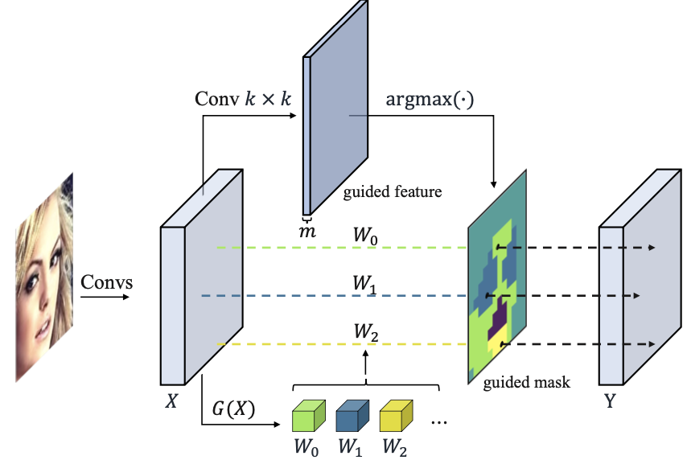
Introduction
Main Idea: 1. design a learnable guided mask module to automatically generate the filters’ region-sharing-pattern.
2. divide spatial dimension into several regions and only one filter is shared within each region.
3. filters for different samples and different regions are dynamically generated based on the corresponding input features.

Slide 4

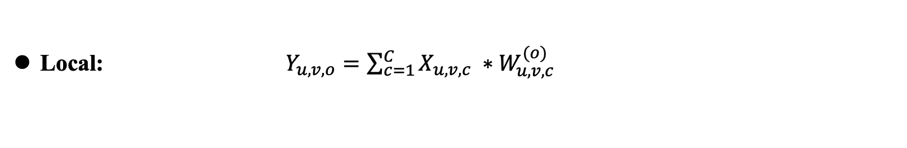
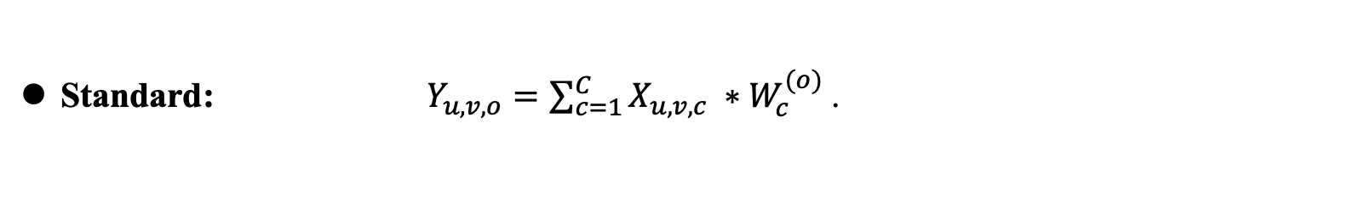
Method – Dynamic Region-Aware Conv
$X ∈ ℝ^{U×V×C},S∈ℝ^{U×V},$ $Y ∈ ℝ^{U×V×O},W∈ ℝ^{C}$.
Standard: $Y_{u,v,o}=\sum_{c=1}^{C}{X_{u,v,c} ∗W_{c}^{(o)}}$.
Local: $Y_{u,v,o}=\sum_{c=1}^{C}{X_{u,v,c} ∗W_{u,v,c}^{(o)}}$
DRConv: $M=\{S_{0},S_{1},…,S_{m−1}\}$ , $W=\{W_{0},W_{1},…,W_{m−1}\}$.
$$Y_{u,v,o}=\sum_{c=1}^{C}{X_{u,v,c} ∗W_{t,c}^{(o)}}$$

Slide 5
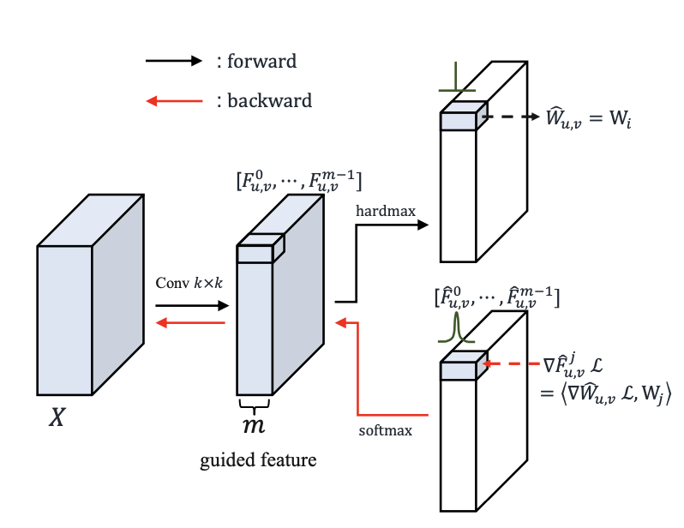

Method – Learnable guided mask
$F ∈ ℝ^{U×V×m},M∈ℝ^{U×V}$.
$$M_{u,v}=argmax(F_{u,v}^{o},F_{u,v}^{1},…,F_{u,v}^{m−1})$$
Forward: hardmax(arg).
Backward: softmax.

Slide 6
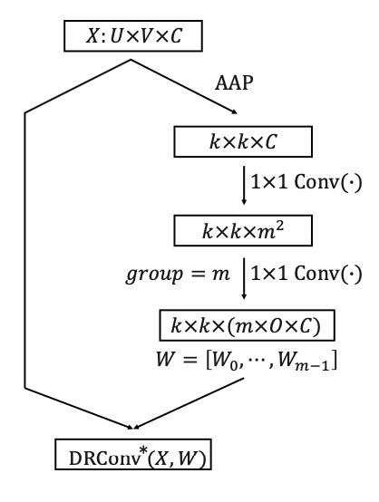
Method – Dynamic filter
AAP: adaptive average pooling

Slide 7
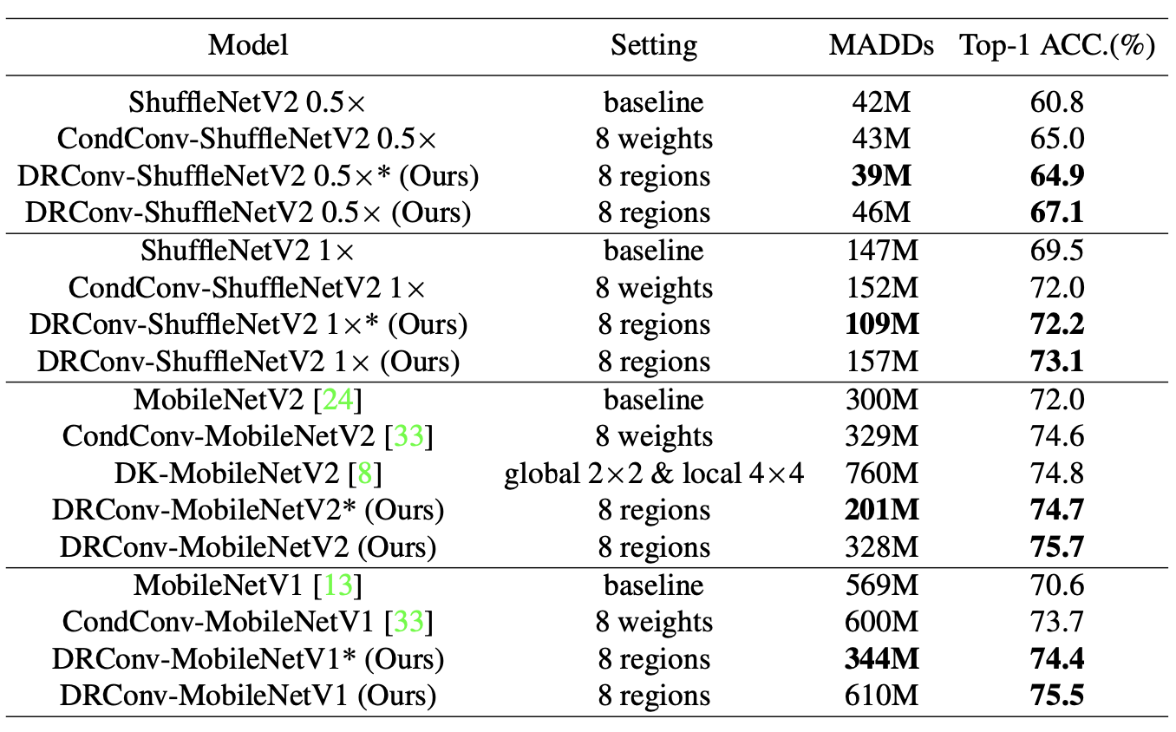
Experiment-Classification
the number of multiply-adds
operations

Slide 8
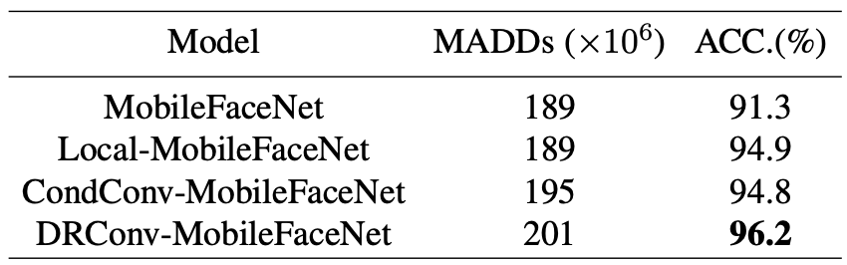
Experiment-Face Recognization

Slide 9
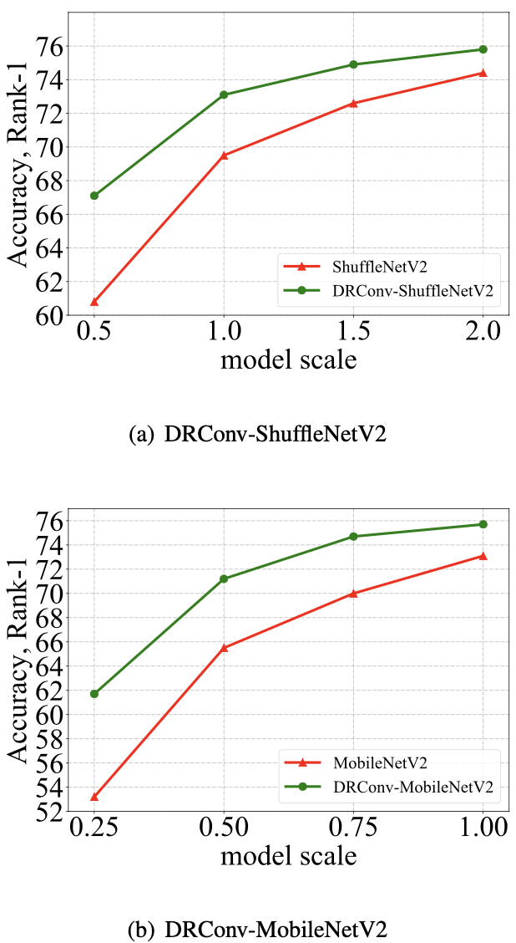
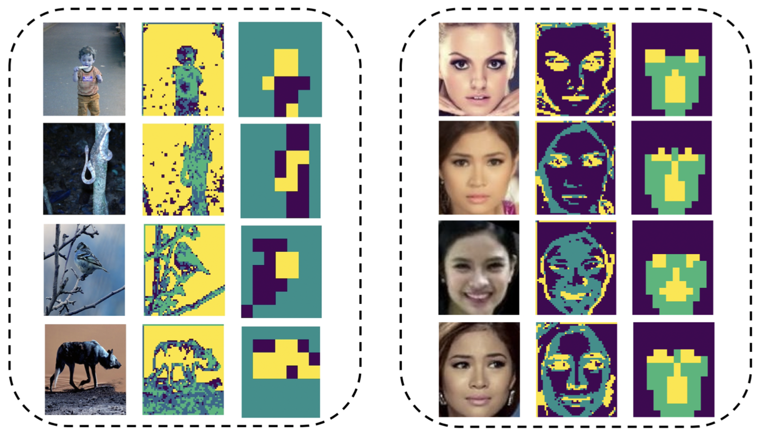
Experiment-Ablation Study
Visualization
Model Size

Slide 10
Conclusion
DRConv can entirely become substitute of standard convolution in any existing networks .
DRConv can maintains translation-invariance.
More effective.

Slide 11
Thank you (Q&A)
Notes:
RP Shortcomings：1.relative position has multi result. 2.CNN learn trivial features. 3. not whole picture.

